Slide 1
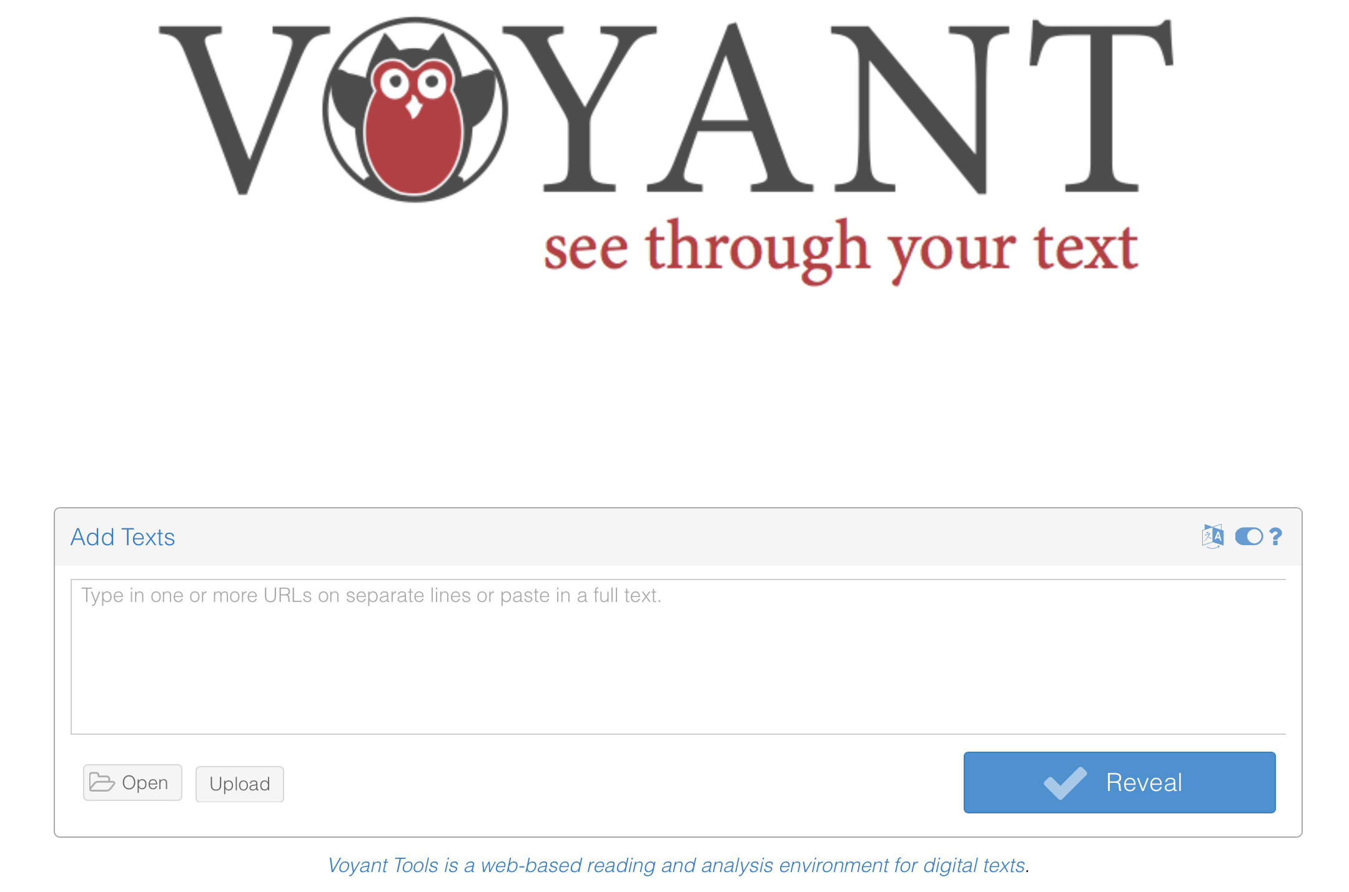
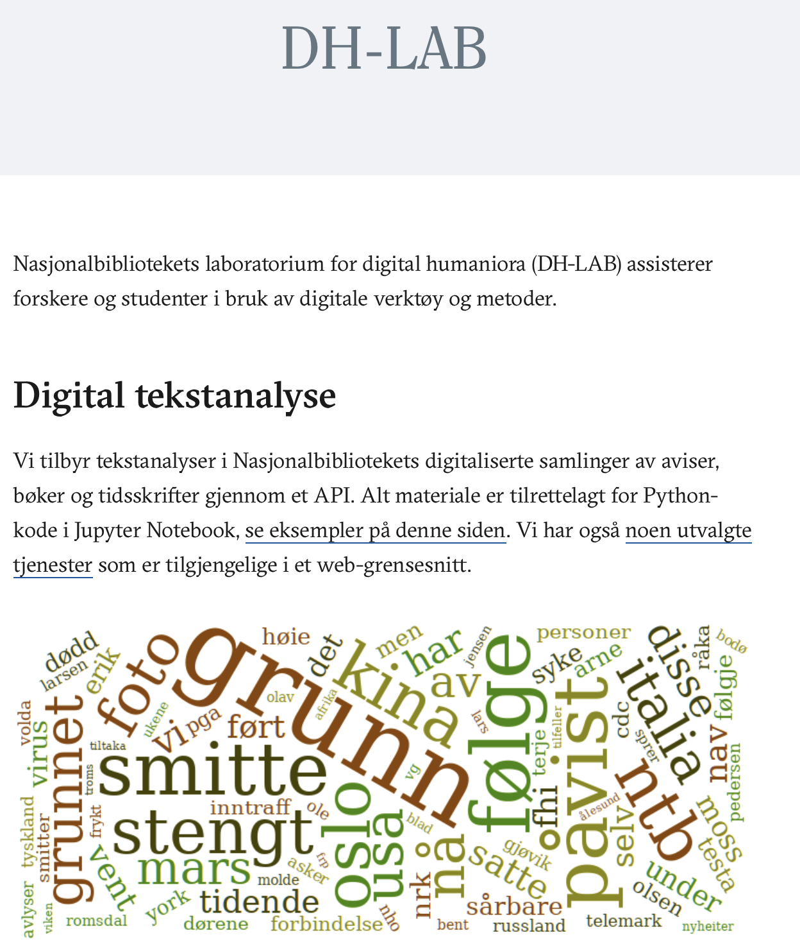
Content
What is text mining?
Voyant tools as example of tool for analysing text files and URLs
The Norwegian National Library’s API for researchers
Text mining with apps (Python)
Text mining with Jupyter Notebook (Python)
Text Mining and Fake News Detection
Natural Language Processing (NLP). NLTK (Python)
Methods:
N gram search. Frequencies
Concordance analyses
Collocation analyses
Sentiment analyses
Notes:
https://www.bbc.com/news/science-environment-63636435
https://www.bbc.com/news/science-environment-63617400
https://edition.cnn.com/2022/11/14/world/cop27-banned-biden-speech-protesters-climate-intl/index.html
https://edition.cnn.com/2022/11/16/world/cop27-loss-and-damage-negotiations-climate-intl/index.html

Slide 2
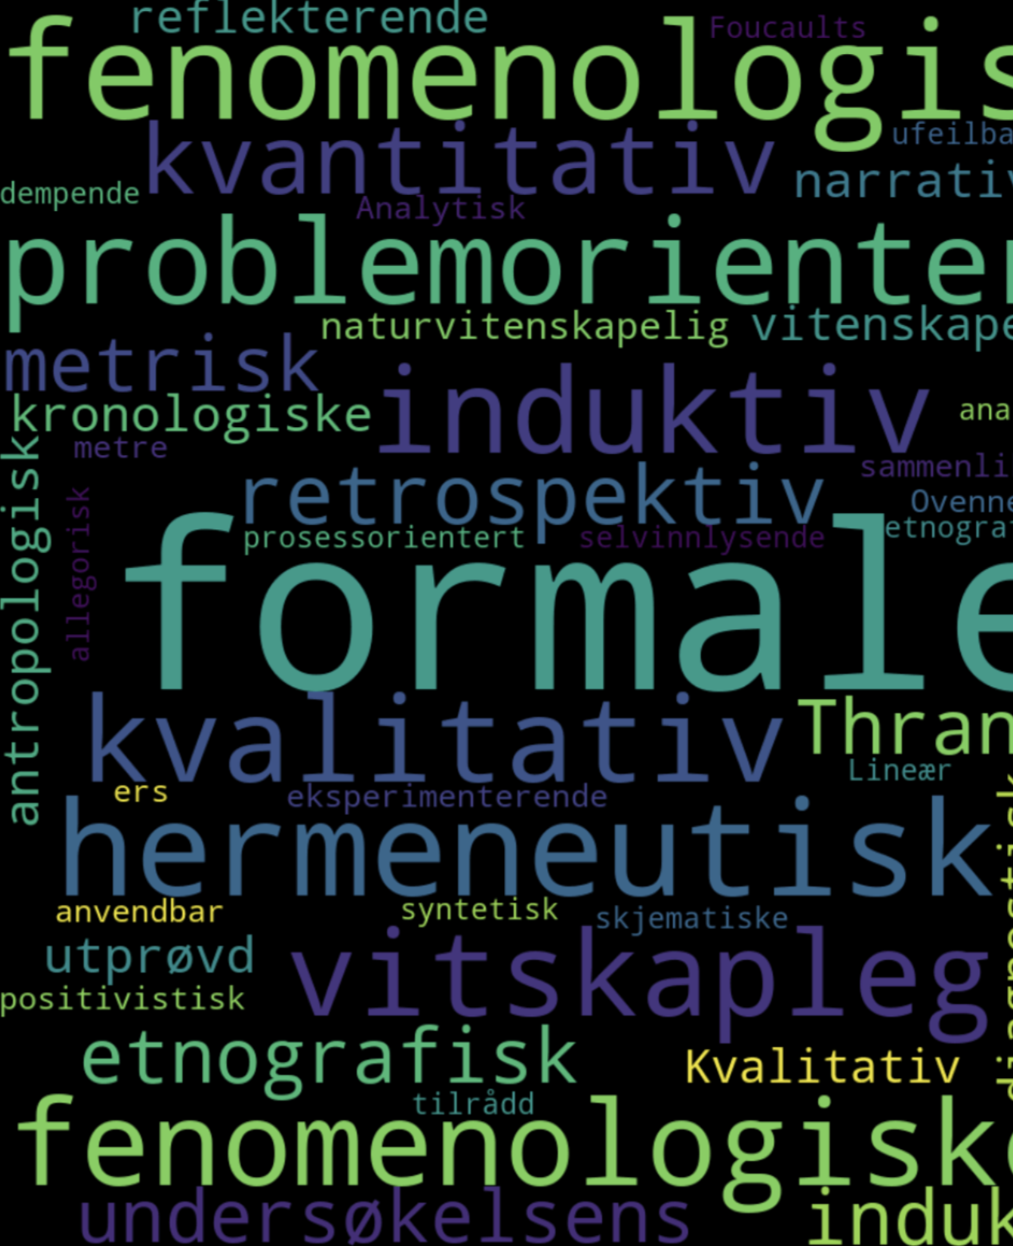
What is text mining?
The use of digital tools to search for, extract and analyse text data.
“Text mining or text analytics is an umbrella term describing a range of techniques that seek to extract useful information from [...] the unstructured textual data of documents – such as books, web pages, emails, reports or product descriptions” (Maarten Truyens og Patrick Van Eecke. 2014)]
Corpus
continuous mass of text of which we can conduct automatic and systematic analyses

Slide 3
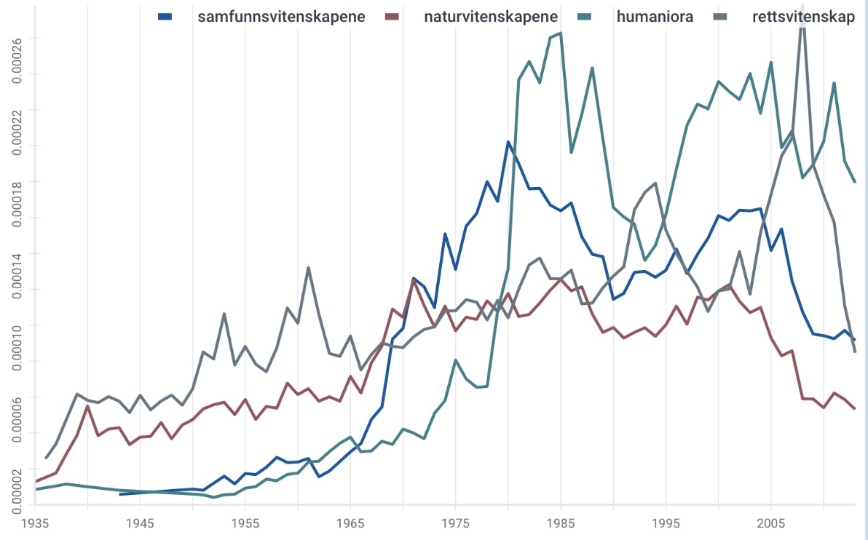
Why text mining?
Overview of patterns in large text masses
Provide insight which would have been very difficult and time-consuming to reach using qualitative methods only
Identify research questions
Investigate research questions

Slide 4
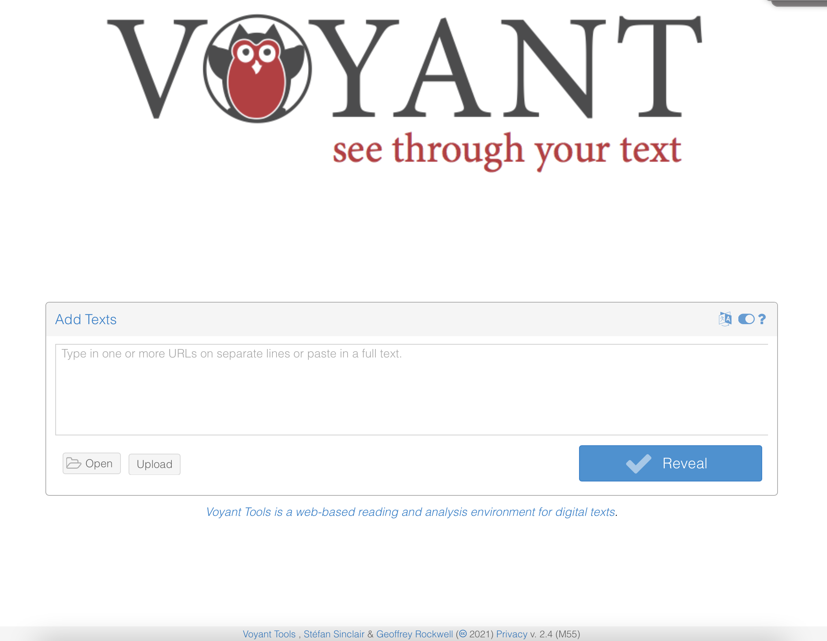
Voyant Tools
https://voyant-tools.org
https://voyant-tools.org/docs/#!/guide/about
[TUTORIAL [Coming! ]]
Try out Voyant Tools:
Create a corpus by adding Urls or uploading files.
Try out different tools to explore your corpus.
Make sure you are able to make use of other tools than those who are visible by default.
Compare terms in two corpora, i.e. the difference between the releative frequency of terms
Inspect the stopword list and make sure you are able to switch to another stopword list as well as modifing a given stopword list.

Slide 5
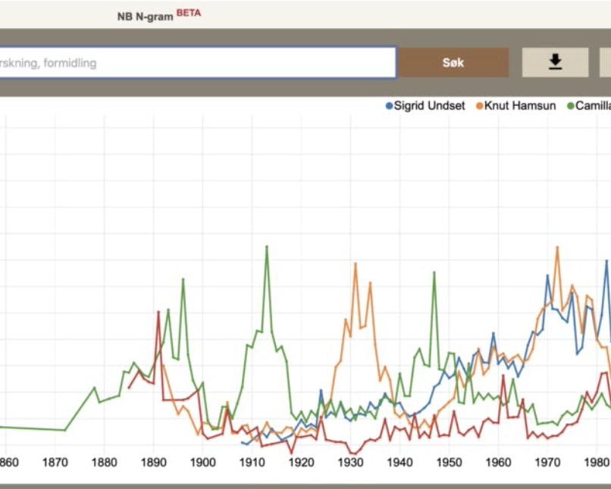
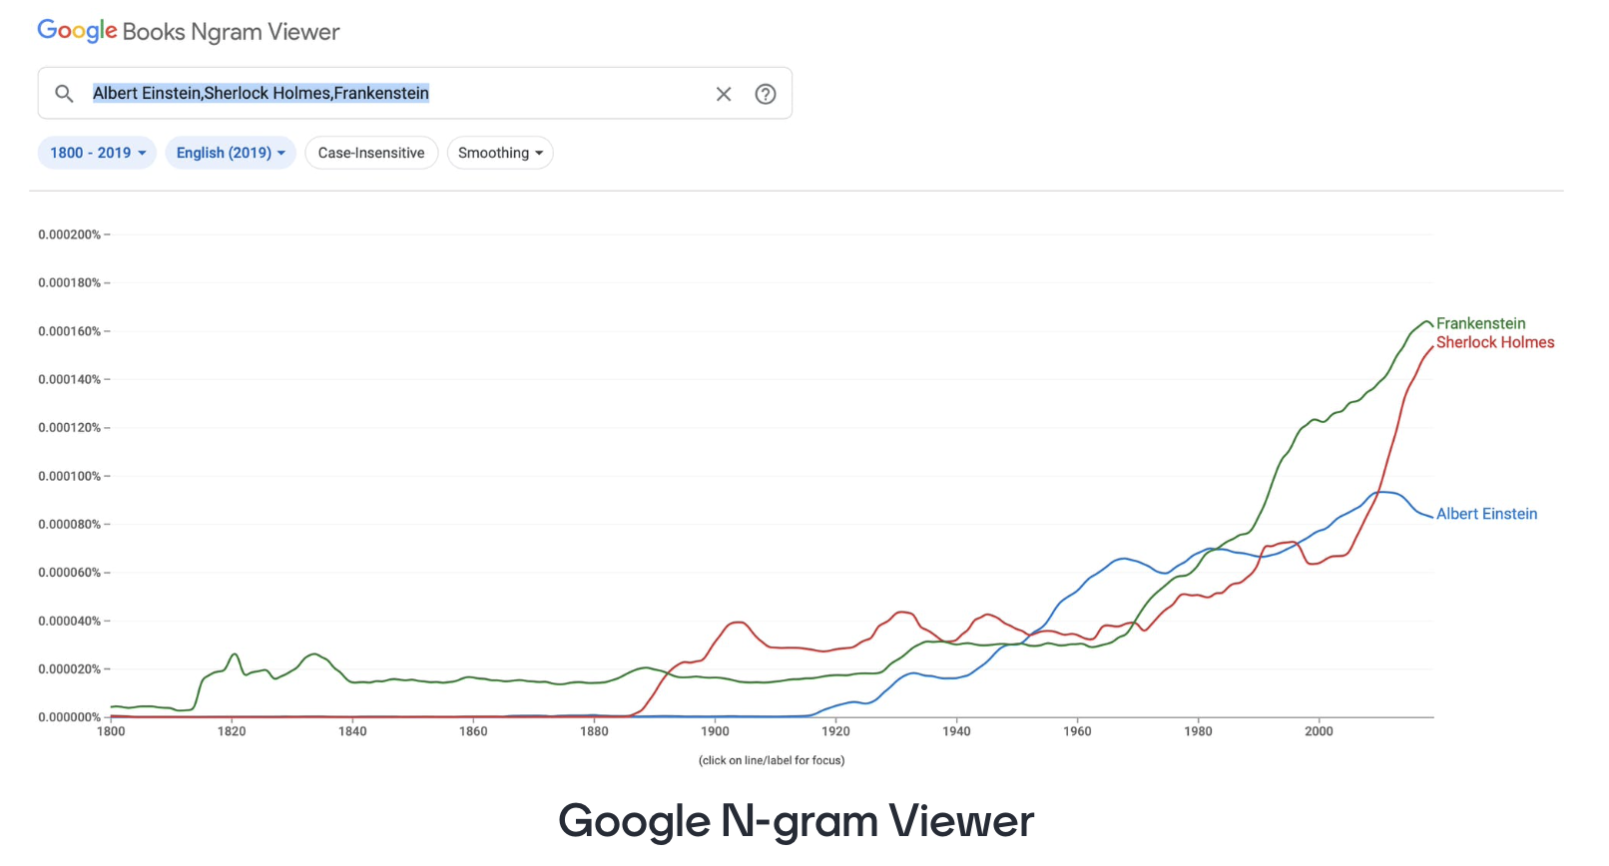
Ngram
N-gram – sequences of one or more elements
Words, letters, phonemes
Unigram: “Pandemic"
Bigram: "climate change”
Trigram: "Second world war"

Slide 6
Links N-gram engines
[TUTORIAL: Coming!]
https://www.nb.no/ngram/
https://books.google.com/ngrams
Trendlinjer: Dagsplott for aviser: https://beta.nb.no/dhlab/dagsplott/

Slide 7
Your turn
Try one or several of the n gram/word frequency engines searching with relevant terms for your research or interests. Adapt/delimit the corpus to a relevant time frame.

Slide 8
Concordance analyses
The concept concordance(concordantia, ‘overensstemmelse’): an alphabetic list of words in a text and where they are located. In digital corpora: list of the occurrences of a word in context (a determined number of words before and after target word).
Purpose: quick overview of how a word is used across a digital text collection
App for concordance analyses through the API of NBs DH-lab: https://beta.nb.no/dhlab/concordances/

Slide 9
Collocation analyses
The concept collocation: words which are associated with one another
In corpus linguistics and text mining: collocations -> statistical calculations of words which have a relatively high co-occurrence with a target word
Purpose: may contribute to the study of transitions in discourse
App for collocation analyses through the API of NBs DH-lab https://beta.nb.no/dhlab/collocations/

Slide 10
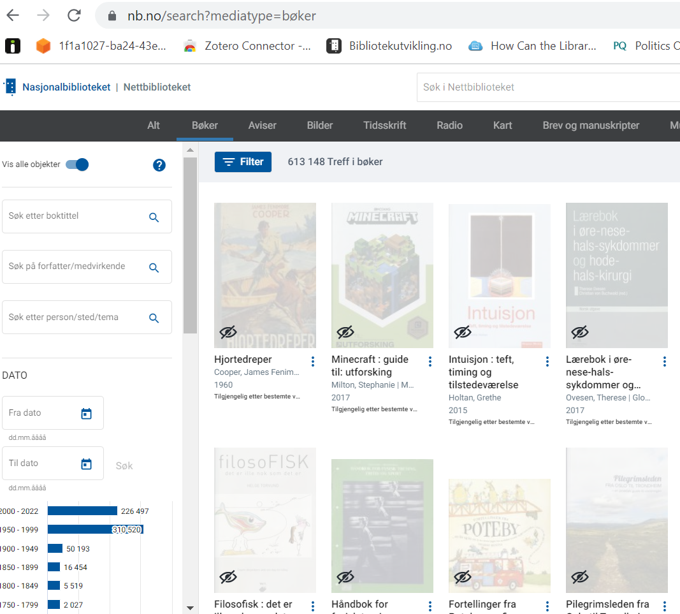
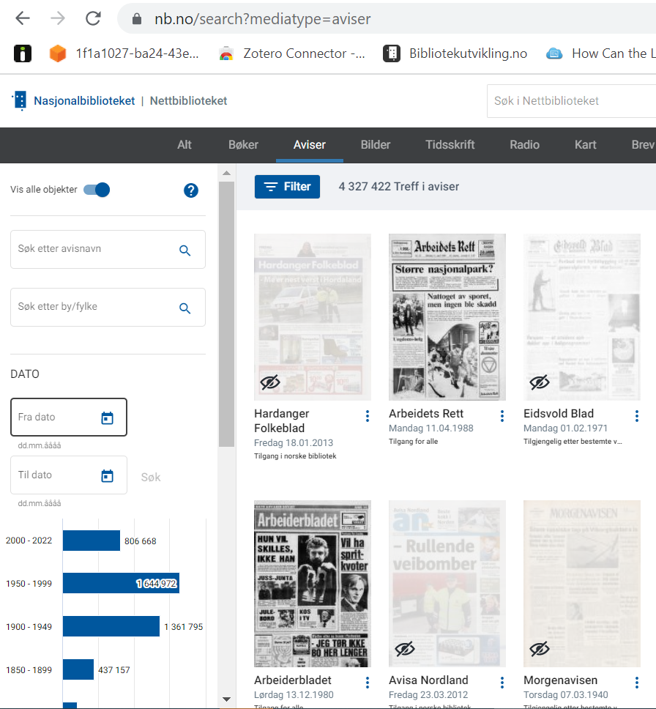
Nb Digital and DH-LAB [Tutorial Coming!]
https://www.nb.no

Slide 11
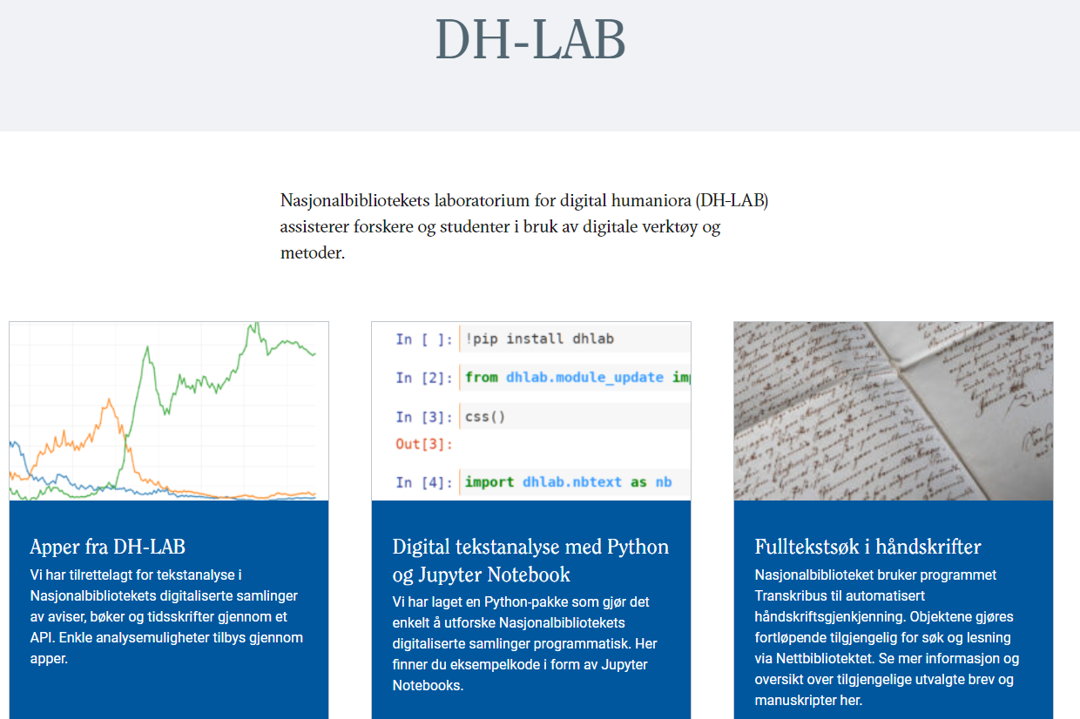
Nb: DH-Lab
https://www.nb.no/dh-lab/

Slide 12
Text Mining and fake news
Reddy, Harita et al. (2020). “Text-mining-based Fake News Detection. Using Ensemble Methods”
Stylometric analyses and word vectors
Quotes and uppercase letters

Slide 13
Resources
News text analysis with Eikon Data API: A Python Tutorial
Natural Language Processing with Python: Real Python’s Tutorial
Web Scraping with Python: Real Python’s Tutorial
Twitter Scraping: DMI-TCAT (Digital Methods Initiative for Twitter Capture and Analysis Toolset) https://www.youtube.com/watch?v=ex97eoorUeo&t=1s (DMI-TCAT)
Reddy, Harita et al. (2020). “Text-mining-based Fake News Detection. Using Ensemble Methods”

